Slide 1

https://www.uni-goettingen.de/en/48115.html
Chapter 12 of <Breeding Method>
UNPLAB-BrMeth_Ch12[TheFour IV]
Clone Breeding; Population Breeding, Hybrid Breeding

Slide 2
Sequential Number: #30
UNPLAB-BrMeth_Ch-12[TheFour IV]
Start with Clone Breeding; continue with Population Breeding,
go on to Hybrid Breeding.
Unless I explicitly state otherwise, images and cartoons are created using ChatGPT.
You may use this material free of charge under the terms of the CC BY license. This requires that you provide appropriate attribution to the author: W. Link, University of Goettingen, Germany.
In a few cases, individual images, photographs, or similar material may be subject to a more restrictive Creative Commons license. Where this applies, it is explicitly indicated, and you must comply with the stated license terms for those items.
Please check the license information carefully before reuse. Responsibility for complying with the applicable license terms rests entirely with you.
2

Slide 3
You already know:
Population Genetics. Genotype frequency, Allele frequency, Hardy-Weinberg-Equilibrium, Inbreeding coefficient, Kinship, Selection, Drift, Migration, Mutation.
And you have already studied GxE and the Breeder’s Equation and Recurrent Selection which is Pre-Breeding.
You already have seen the pertinent Selection Method in Line Breeding plus Maintenance Breeding plus Backcrossing as approach in Line Breeding ... plus a look into Prediction of a Marker Score based on significant QTL and/or discussing Genomic Estimated Genetic Values.
Keywords of this chapter: Clone Breeding. Hybrid Breeding. Population Breeding. Select components of Synthetic Cultivars based on their GCA, or, even better, based on their GVA.
Algebra as introduced in this chapter: none
3

Slide 4
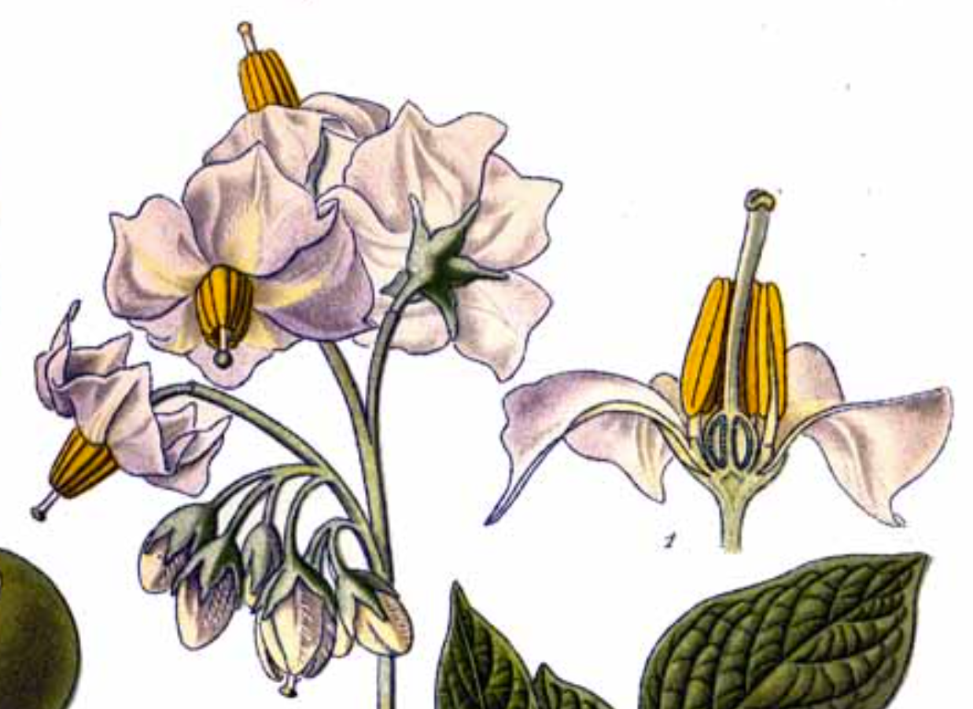
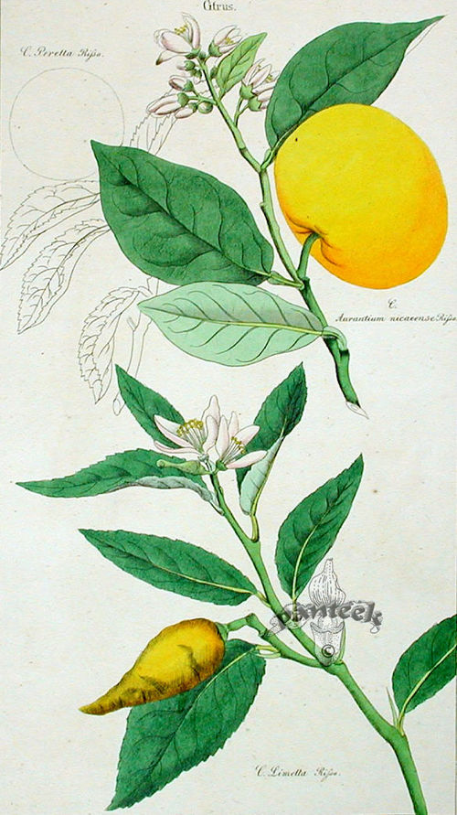
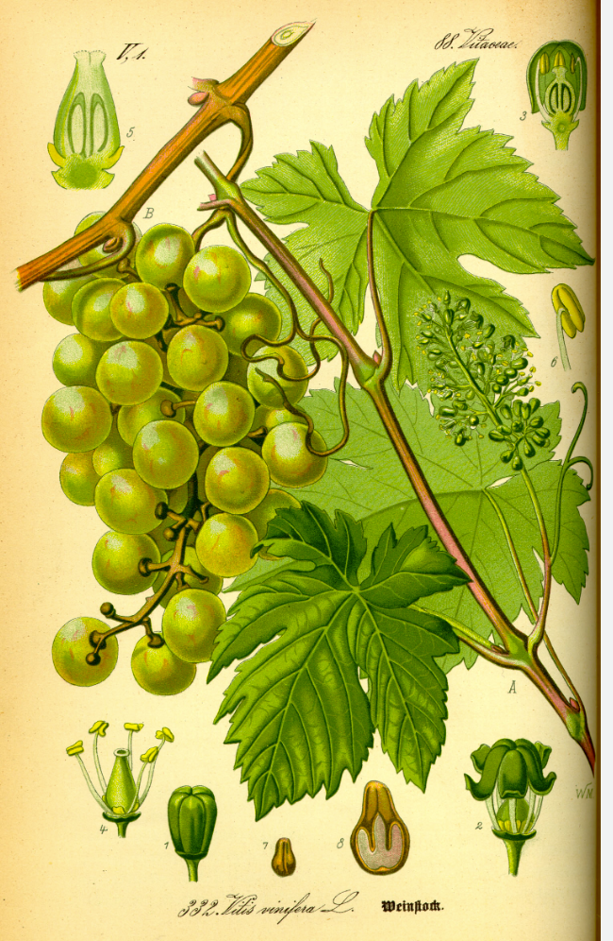
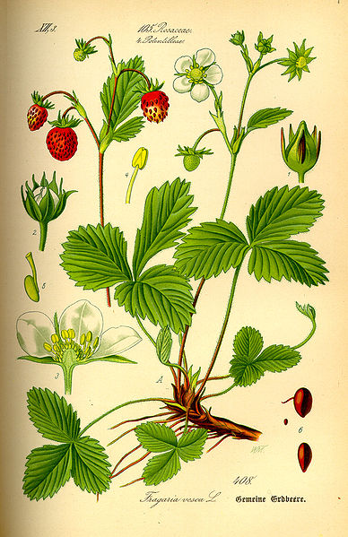
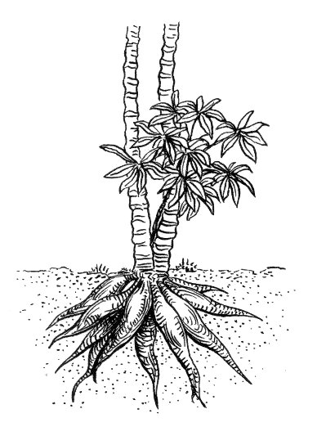
Diverse species fall in the category of Clone Breeding (e.g. potato, cassava, strawberry, fruit trees such as citrus, grape vine). For many of them, ‘we’ are the direct customer!
Solanum tubero-sum A. Masclef
Atlas des plantes
de France. 1891.
Vitis vinifera;
Fragaria sp.
Thomé. Flora
von Deutschl., Österreich und
& Schweiz. 1885
Manihot esculen-tum
Archives of Pearson Scott Foresman
Citrus limetta
D. Dietrich's Flora Universalis, 1831 Jena
4

Slide 5
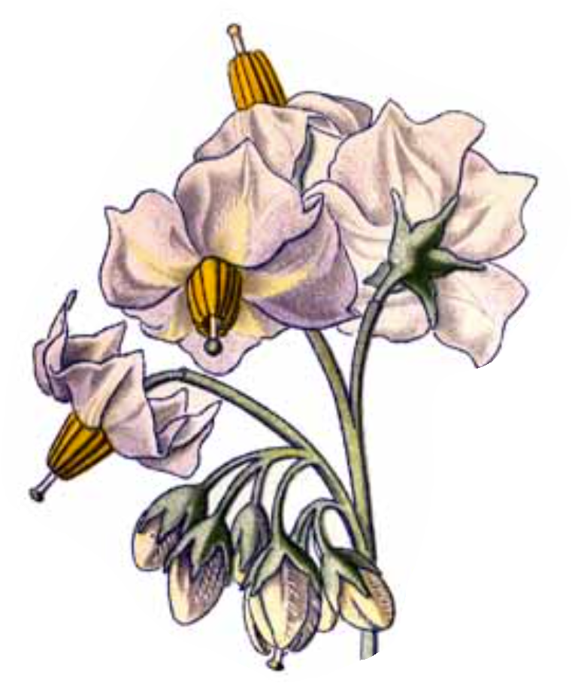
Clone Breeding. The parents that are crossed are (usually) not homozygous.
Clone breeding is for vegetatively reproducing crops. Farmers do buy tubers, plants, cuttings, other types of vegetative ‘propagules’. Be cautious: Even if one may buy onions (onion sets, Steckzwiebeln) which were vegetatively propagated, this is probably not Clone Breeding; because the field which produced the onion sets was probably sown from hybrid seed: From an onion hybrid cultivar.
Genotypes of clone-bred crops do not change across generations of their vegetative propagation. Yet: We need genetic variation for bree-ding! Therefore: As basic step of Clone Breeding we break the gene-tic constancy by a sexual generation. Two genotypes are crossed, hybrid seeds are harvested and sown as hybrid generation. This F1-generation (itself) segregates! This is not a Mendelian F1-hybrid. The hybrid offspring are evaluated. From now on, offspring genotypes are (again) vegetatively propagated. Each hybrid seedling is the vege-tative ancestor of a candidate cultivar. The further breeding is ‚just‘ a multi-step selection process between these (vegetatively fixed) new genotypes, the ‚best‘ one(s) will be identified as new Clone Cv(s).
Cross parents
Select seedlings
Select ‚A‘ clones
Select ‚B‘ clones
Select ‚C‘ clones
In potato, grapevine, strawberry etc., the direct consumer is a ‘picky’ human. Therefore there is a plethora of traits to follow. That makes clone breeding complex and demanding.
Experimental cultivar
5

Slide 6
What else to discuss on Clone Breeding before we leave it in a hurry?
Cross parents
The vegetative material sold to gardeners
and farmers is much more likely to contain
nematodes, viruses and other undesirable
elements compared to seeds. Seeds are usually
‘clean’ and healthy.
Therefore, Clone Breeders are typically specialized in methods of cleaning, purifying vegetative plant material.
The mostly used approach is meristem culture. Tip of meristems are typically free from viruses and hence a cultivar in grape vine or hemp or apple tree ... that may after long years of (re)production be infected and infested can (should) be ‘cleaned’ by regeneration from such clean meristem tissue (DOI 10.4236/ajps.2020.1111131).
Autopolyploidy and polyploidy in general may to some extent com-plicate regular meiosis hence seed production. This is of lesser importance if the species ‚anyway‘ propagates usually via tubers or the like. Hence, we find polyploidy repeatedly in Clone Breeding, making genetics and thus breeding complicated and challenging (e.g. potato, strawberry, banana, yams, sweet potato).
6
Select seedlings
Select A clones
Select B clones
Select C clones
Experimental
cultivar

Slide 7
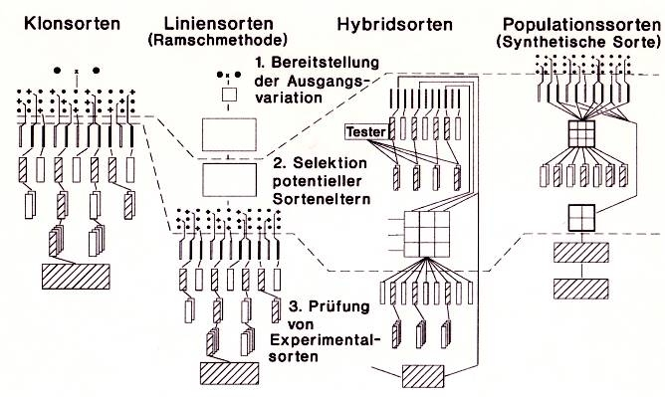

Classical, famous display of Categories in Plant Breeding
1 Release initial variation
2 Select parents of candidate cvs.
Three discernible phases in breeding schemes:
Release of initial variation
Selection of parents of candidate cultivars
Test of experimental cultivars
3 Test the experimental cvs.
Next: Population Breeding
7

Slide 8
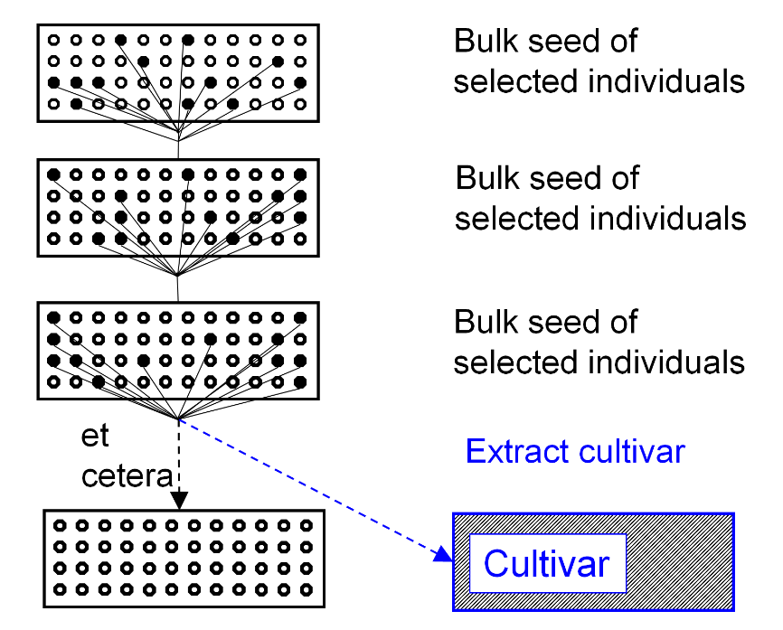
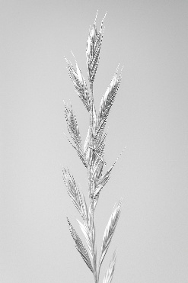
Population Breeding, one of four categories in Plant Breeding. Here: Recurrent Mass Selection as scheme to develop a Population Cultivar.
Scheme is from ‚Recurrent Selection‘, yet, it is fine as Population Breeding scheme for Cultivar Development as well.
Pre-breeding as Recurrent Selection of an outcrosser such as Lolium multiflorum and actual Cultivar Development may look similar.
Recurrent Mass Selection realizes gain from (mass) selection in each season, no need of staggering, it is cheap even with large numbers of candidates; hence even with very strong selection, the number of selected individuals can be high, thus very little Drift. To extract a cv., seed from a fair number of ultimately selected individuals have to be joined to reduce Drift-caused inbreeding depression in the cultivar.
Undesirable genetic changes in a population (via Drift, Migration, Natural Selection) can only be mended if back-up seed was stored.
Lolium
Et cetera
8

Slide 9
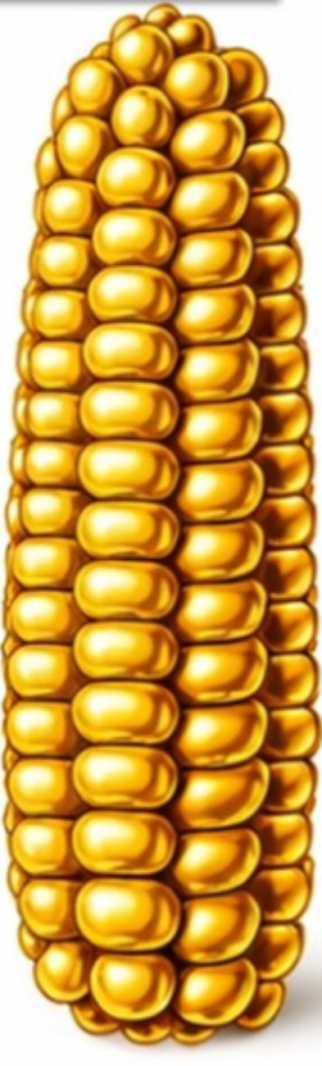
Population Breeding, one of four categories in Plant Breeding. Here: Ear-to-Row Recurrent Selection (Iowa) as scheme of Population Breeding (develop population cv).
Base population
Select individuals
As said before: Population Breeding is tightly connected and in many cases hard to distinguish from Recurrent Selection of cross-fertilizing crops.
This scheme shows Ear-to-Row-Selection Method. It can be applied to a crop such as corn or sunflower; not only to im-prove a population as breeding germplasm (Pre-Breeding), but as well to create an improved version of the population as new cultivar.
Such population cultivars used to have a long live on the market, because breeders used to subliminally improve such cultivars (through further recurrent selection instead of strict Maintenance Breeding). Obviously, with this habit, pre-breeding, recurrent selection, and cultivar development overlapped.
Today, with the legal requirement (DUS) for cultivars (distinctness-uniformity-stability), this strategy has died out. Instead, old population cvs. are taken from the market and replaced by new, (further) improved ones.
Select families & individuals within
Select families & individuals within
Select families & individuals within
Extract cultivar
Cultivar
9

Slide 10
Basic scheme of breeding a Synthetic Cultivar (for outcrossers only, needless to say)
Maintain (preserve, keep, retain) selected clones or inbred lines, selected as synthetic cultivars‘ components.
Base population
Organize a Polycross (or Topcross) with these candidate components, to produce seed for Polycross-Test (or Topcross-Test).
Take clones or extract inbred lines as candidate components of synthetic cultivars
Polycross-Test (or Topcross-Test): Field trial to assess agronomic performance; estimate GCA of the candidates.
This red barrier line indicates that grains (seed) har-vested from the field trial (to assess GCA) is not used as seed again. Instead .. blue line ;-)
Select. Go back to the maintained candidate components. Find optim. number of compts., join best ones, grow them as generation Syn-0.
No selection
any more
Grow random-mated offspring from Syn-0 as generation Syn-1.
Grow random-mated offspring from Syn-1 as generation Syn-2.
Go to Syn-3 or Syn-4, get your candidate synthetic cultivar tested by the authorities (and hopefully approved), sell seed in synthetic generation ~beyond Syn 3 to farmers.
10

Slide 11
Same thing again, in different guise. Just because I like the topic and because it is enlightening – not being too trivial ;-)
Go back to the topics Heterosis; GCA; SCA (UNPLAB-BrMeth_Ch-3[GCAI] and Ch-4[GCAII]). Number of possible combinations of N if you have K components to choose from: K!/(K-N)!N!
Example:
Make synthetics with N=8 components and have K=10 components to choose from – 45 different synthetics are possible.
Make synthetics with 8 components and have 50 components to choose from. An insane number of 539.9∙10⁶ different synthetics are possible.
Message: You can not test them all. Prediction is needed!
11

Slide 12
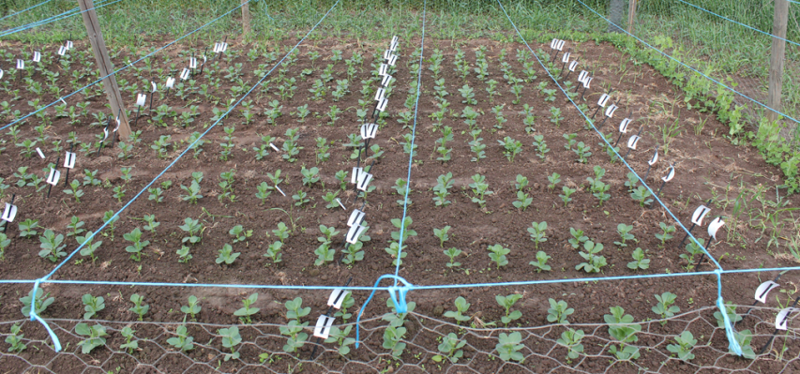
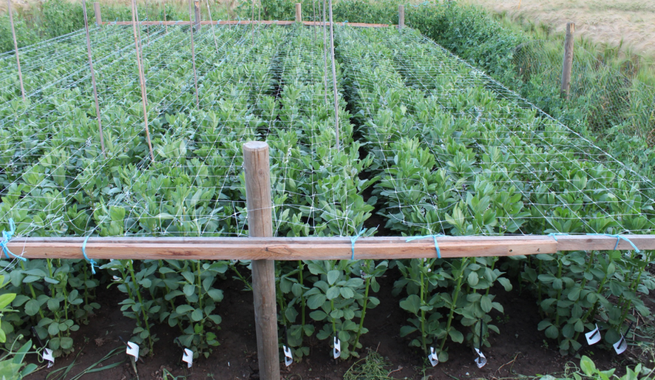
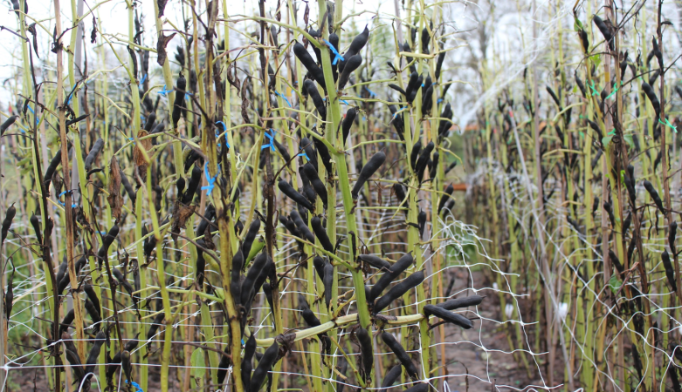
Breeding synthetic cvs.: A method (in the category of Pop. Breeding) that allows to re-synthesize a cultivar from components (no need to store seed of the entire population).
Start with a diverse breeding population of a fully (or at least partially) cross-fertilizing crop such as Medicago sativa, Trifolium pratense or Vicia faba.
M.s. or T.p.: Candidate components are clones (perennial). Vicia faba: Components are inbred lines. In both cases, components can be maintained (kept, retained, preserved) without genetic change.
© L. Brünjes
Polycross (each cross with each)
Polycross and Polycross-Test. Identify the candidate components with highest (best) GCA effects. Join them to grow first (Syn-0) generation of a synthetic cultivar. Syn-0 may be a mixture of several (many) individuals per component clone (non-inbred) – or Syn-0 may be a mixture of inbred lines with very many individuals per component (inbred line).
In both cases, the cultivar would not go as Syn-1 to farmers but in a later generation (probably Syn-3 or beyond). DOI 10.1515/9783110837520 (chapter 8).
●●●●
Polycross-Test
12

Slide 13
Synthetic cvs.: Assess components via their Polycross-Progenies. Selection criteria? Number of components? Syn-generation for the certified seed (seed sold to farmer)?
13
Selected compnts.
Select between components (clones, lines) based on their GCA (assessed via Polycross-Test). Choose few best ones, join them (replant clones or mix seed) to Syn-0. Syn-0 is typically realized as open-field plot with spatial isolation from other plots (of same species) (>100 meters, depending on wind or insect pollination).
Such Syn-0 could be substituted by controlled-crossing all components to each other (as Diallel cross or as round-robin design or chain-crossing design ... or the like).
DOI 10.1534/genetics.109.108449
Be aware whether in this way the Syn-1 generation is without inbreeding – the controlled crosses may have prevented inbree-ding; if so, then only after one generation of natural mating (probably from Syn-1 to Syn-2) such inbreeding will be realized.
Only after this, the performance of the population may stay constant across further generations.
With N components, F=1/N (components are homozygous lines) or F=1/2N (non-inbred clones; anyway diploid!)
Polycross (each cross with each)
Syn-0 (each with each)
●●●●
Syn 1
Polycross-Test
Syn 2
Syn 3 = Certified seed

Slide 14
Synthetic cvs.: Assess components via their polycross-progenies. Selection criteria? Number of components? Syn-generation for the certified seed (seed sold to farmer)?
14
Selected compnts.
With N components and components are homozygous lines, the cultivar is inbred by inbreeding coefficient F=1/N. The more components we join, the lesser the inbreeding. Yet, the larger N, the weaker we select, the smaller the Gain from Selection. There is an optimum N, depending on genetics of the breeding germplasm and trait. Oftentimes 3 < N_{optimum} < 12.
Should the components be selected based on GCA only?
GCA is an inbreeding-free parameter (grasp this point fully!). Obviously, we should - to a small extent - include the effects of inbreeding depression in our selection. Useful components combine high GCA with little inbreeding depression. This consideration leads us to GVA (general varietal ability) as substitute for GCA.
https://s.gwdg.de/z2DxBJ
DOI 10.1111/j.1439-0523.1993.tb00561.x
Our default considerations here are focussed on diploids. With autopolyploids, the relationship between performance and inbreeding-related parameters is more complicated.
DOI 10.1515/9783110837520 (chapters 2.4 and 11)
Polycross (each cross with each)
Syn-0 (each with each)
●●●●
Syn 1
Polycross-Test
Syn 2
Syn 3

Slide 15
15
Synthetic cultivars. Optimum number of components.
The optimum N of components (compromise between as little as possible inbreeding and as strict as possible selection) depends, among other factors, on the number of available components. For instance, having 12 components to choose from, the expected superiority of the best and second-best over µ (normal distribution σ²=1) is 1.62923 and 1.11573. Having e.g. 36 to choose from, you find for the best and second-best these figures: 2.11812 and 1.70362. Of course, the best ones out of 36 are expected as superior vs. the best ones out of 12.
Yet … the difference between best and second-best is larger in the smaller set (0.5135) than in the larger set (0.4145); it further shrinks as the set becomes even larger. The message is: If you select from many candidates, the penalty of using many components instead of only the best one is expectedly smaller than if you select from few candidates, yet, the inbreeding avoidance of haven more such as 6 instead of only 3 is (expec-tedly) the same (well, ceteris paribus, if the small number of candidates is a representative sample of the large one).
Thus, the optimum number is the larger, the larger the number too choose from is – and causes less inbreeding depression.
Selected compnts.
Polycross (each cross with each)
Syn-0 (each with each)
●●●●
Syn 1
Polycross-Test
Syn 2
Syn 3

Slide 16
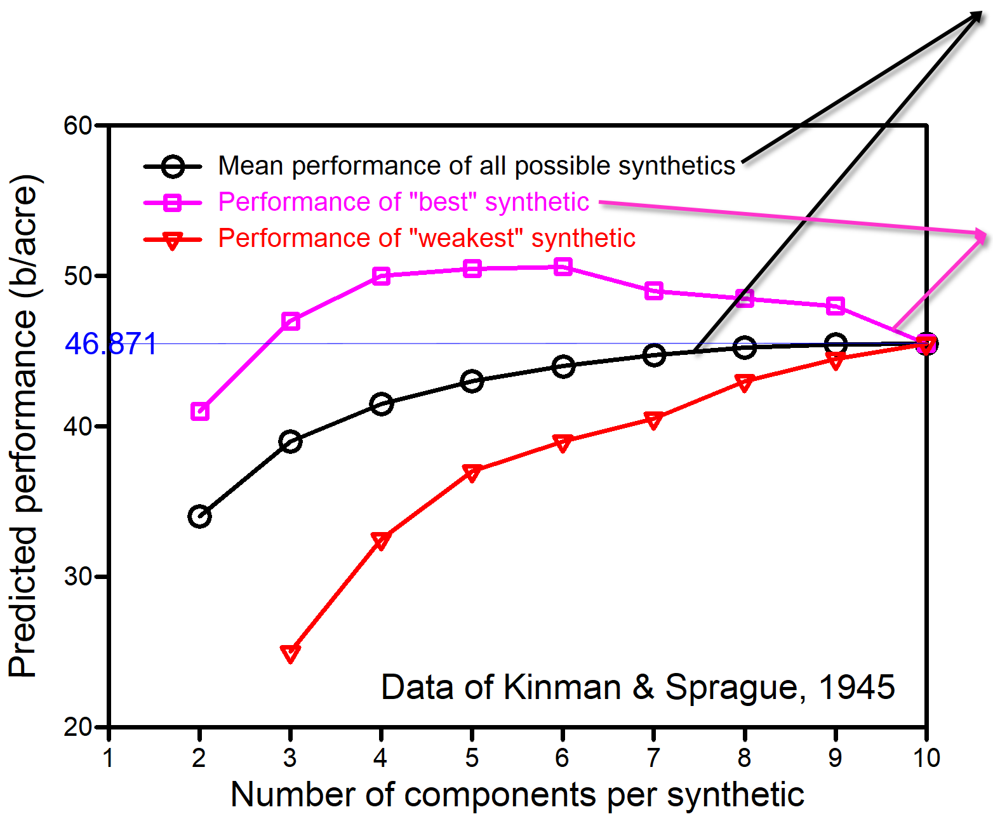
Ø 45 F1-hyrids: 50.09; Ø 10 inbreds: 17.90. => Mean of the N=10-Synthetic (Sewall Wright: UNPLAB-BrMeth_Ch-4[GCAII]). Y = C – (C-S)/N, hence 50.09 – (50.09-17.90)/10 = 46.871
 Mean performance of all ‚makeable‘ syn-thetics with 10 components to choose from increases with increasing number of com-ponents N. Trend is because the inbreeding penalty reduces from ½ with N=2 to 1/10 with N=10.
□The performance of the best ‚makeable‘ synthetic increases with N, from N=2 up to N=6. Further increase of N reduces the per-formance of the best synthetic, obviously because the inclusion of the 7th best component (7th of ten means it is an inferior component) reduces the overall performance more that the heterotic gain that it realized (heterotic gain from reduced inbreeding; reduced from F=1/6 with N=6 down to 1/7 with N=7). With N=7 or more, we missed the optimum number of components. Perfor-mance of the only makeable synthetic with N=10 is what the Sewall-Wright equation predicts.
Becker, H.C., 1982- Vortr. Pflanzenzüchtg 1., 23-40
16

Slide 17

Variance between synthetics (population) is much smaller than variance between individual genotypes (think of a synthetic as mean-of-its-components; ignore for a moment heterosis, competition).
We know it: $σ_{\overline{x}}^{2}= {σ_{x}^{2}}/N$. This is true if either the number of candidates to choose from is K=∞; or if we chose the components with replacement (if we accepted in the full set of possible mixtures that components may occur more than once per mixture). Well: Both is not our reality.
Therefore we expect $σ_{\overline{x}}^{2}= {σ_{x}^{2}}/N ∙ σ_{x}^{2}$ ∙ [1-(N-1/K-1)]
Sukhatme and Sukhatme, 1970: Sampling Theory of Surveys with Applications. Iowa State Univ. Press. Page 14.
Arrenberg, J., 1998: Schätzung der Varianz von Mittelwert-Schätzern in endlichen Populationen. Page 134.
17

Slide 18
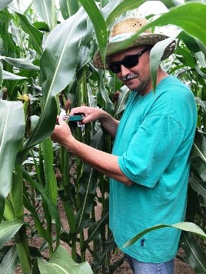
Hybrid Breeding. Have a look how ultra-super short a scheme can be drawn.
Test, select lines
Cross them with a distant line
Test experim. hybrids
Select, produce best hybrid
Experimental cultivar
© W. Link
18

Slide 19
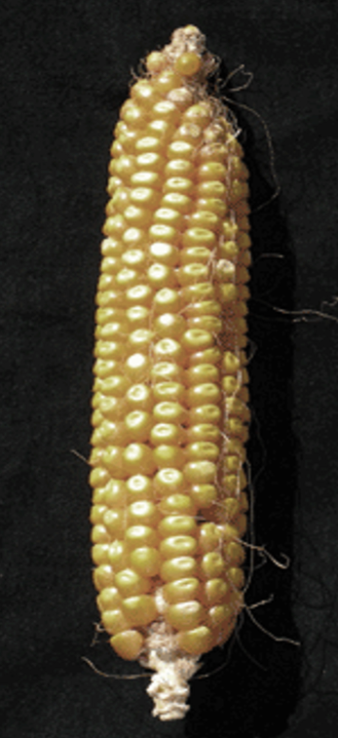
Hybrid Breeding. Have a look how ultra-super short a scheme can be drawn.
Test, select lines
Of course, this scheme is too much abbreviated.
Wherefrom do the initial inbred lines come?
Wherefrom did the paternal (distant) line come?
Cross them with a distant line
© HCB
Test experim. hybrids
The bi-parental single crosses for field testing were produ-ced directly after the selection between the lines? Means: The first selection at F1-level is for [GCA+SCA] and with high crossing-effort - instead of first selecting based on GCA and conducting bi-parental manual crossing only bet-ween the lesser-many lines that showed superior GCA !?
Select, produce best hybrid
Experimental cultivar
The pollinator side is totally neglected here. Just as there is selection between seed-parent lines, there must be selection between the pollinator lines. Ultra-super-short scheme; too short, I would say.
19

Slide 20
Sequence of steps in Hybrid Breeding, with indication of potential numbers & sizes
Germplasm; Genetic material (Numbers: Seasons)
Population A (‚Dent‘)
1
Population B (‚Flint‘)
Develop inbred lines
2
Develop inbred lines
4.000 lines
3;4
4.000 lines
Cultivar development.
5 - 7 years
Time
400 lines
3;4
400 lines
40 lines
5;6
40 lines
4 lines
7
4 lines
4 experimental F1-hybrids
8
© HCB
A1xB1; A2xB2; A3xB3; A4xB4
Employ superior lines as soon as they are identified: Not only for cultivar development, but in addition to breed new lines from crosses between such superior lines; this is the so-called second-cycle breeding (DOI 10.1007/s00122-007-0585-2). Employ Genomic Prediction!
20

Slide 21
Sequence of steps in Hybrid Breeding, with indication of potential numbers & sizes
Germplasm; Genetic material (Numbers: Steps)
Steps (Start again each year: ‘Staggering’)
Population A (‚Dent‘)
1
Population B (‚Flint‘)
Develop inbred lines from base populations.
Select lines via per se performance
Develop inbred lines
2
Develop inbred lines
4.000 lines
3;4
4.000 lines
Topcross & Topcross-Test, select via GCA*
Cultivar development.
5 - 7 years
400 lines
3;4
400 lines
Topcross & Topcross-Test; further tester(s)*
40 lines
5;6
40 lines
Diallel and Diallel test (N²-N)/2=780); Select§
4 lines
7
4 lines
Seed of four best hybrids for official tests
4 experimental F1-hybrids
Official tests for ‚value for cultivation and use‘ and registration tests
(Landeskultureller Wert; Registerprüfung): 3 years
8
A1xB1; A2xB2; A3xB3; A4xB4
§Employ superior lines in addition to breed new lines from crosses, so-called second-cycle breeding.
*Employ Genomic Prediction. Optimize balance between (a) Selection based on genomic estimates of GCA from Genomic Prediction and (b) Selection based on phenotypic GCA data from field (c) and re-training the Genomic Prediction model with fresh phenotypic data (and filtering out old, outdated phenotypic data).
21

Slide 22
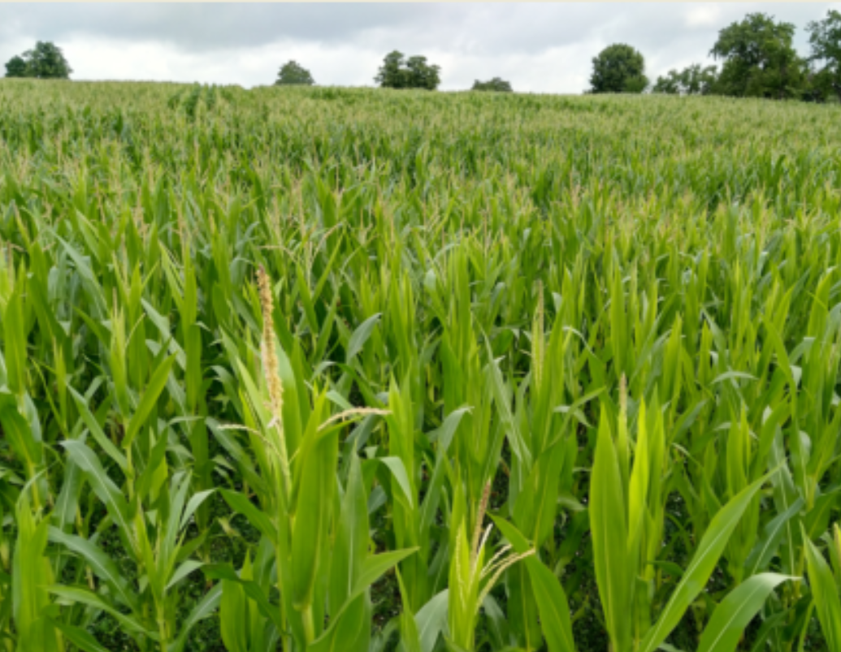
Scheme of breeding a Hybrid Cultivar (by default for outcrossers); follow 8 steps.
Yet. There is hybrid breeding in wheat, rice, barley, tomato. And more self-fertilizing crops are bred like this or are in the pipeline. Why? It is the only option to exploit their (less-marked) heterosis. Further reason? ... cf. farm-saved seed ;-)
Inbred lines
2
1
Base population
Diallel Cross
5
Topcross
Sequence of 8 steps
3
Diallel-Test
6
Topcross-Test
Only one ‚side‘ is shown, second parent-of-hybrid cultivar is developed accordingly - of course ;-)
4
7
8
Two experimental F1-hybrid cultivars, to present them to the authori-ties, to run official trials, to assess them for value for cultivation and use (VCU; Landeskultureller Wert)
© W. Link
22

Slide 23
Basic scheme of breeding a hybrid cultivar (for outcrossers only? Not really ... ;-)
23
Inbred lines
Inbred lines need to be maintained until final decision about their employment as parents of a cultivar. Even before an expe-rimental hybrid is officially released, its lines must be pre-multiplied to not delay marketing of a freshly approved cultivar. And: Several inbred lines may be used for further breeding (so-called ‘second-cycle breeding’).
Factorial Cross (Pool 1 by Pool 2)
Base population
Extract inbred lines as candidates of hybrid cultivars (via line breeding; usually via SSD or DH line breeding (enforced selfing needed).
Topcross
Diallel-Test
Topcross-Test
Only one ‚side‘ is shown! Greyish second parent-of-hybrid cultivar (Pool 2) is developed accordingly - of course ;-)
Seed harvested from the field tests (Top-cross-Test and Dial-lel-Test) is not used as seed again. Instead: See coloured arrows.
Breeders go back to the inbred lines and (multiply and) employ them ...
Two experimental F1-hybrid cultivars, to present them to official trials.
Oftentimes, so-called single-cross-hybrids (singles, two-ways) are bred. Alternatively, 3-way and 4-way cross hybrids may be bred.
SABRAO Journal of Breeding and Genetics, 49 (1) 116-122, 2017
... to create larger amounts of the most-promising hybrids (parent combinations).

Slide 24
From here you may go to UNPLAB-BrMeth_Ch-13[TheFour V]
What did we study in this chapter?
Clone Breeding, the category of breeding if crops are vegetatively propagated and planted instead of sown.
Population Breeding, the category of breeding if cultivars are more-or-less heterogeneous and very little inbred populations and seed is produced by outcrossing and approx. random mating.
Hybrid Breeding. Production of seed for hybrid cultivars must be steered* to prevent selfed seed of seed-mother and of seed-father from entering the certified seed lot.
*usually via CMS.
Other options exist, cf. International Journal of Farm Sciences 8(2): 109-113, 2018); https://s.gwdg.de/bZm4G4;
DOI 10.1111/pbr.12473.
24
24

